Slide 1
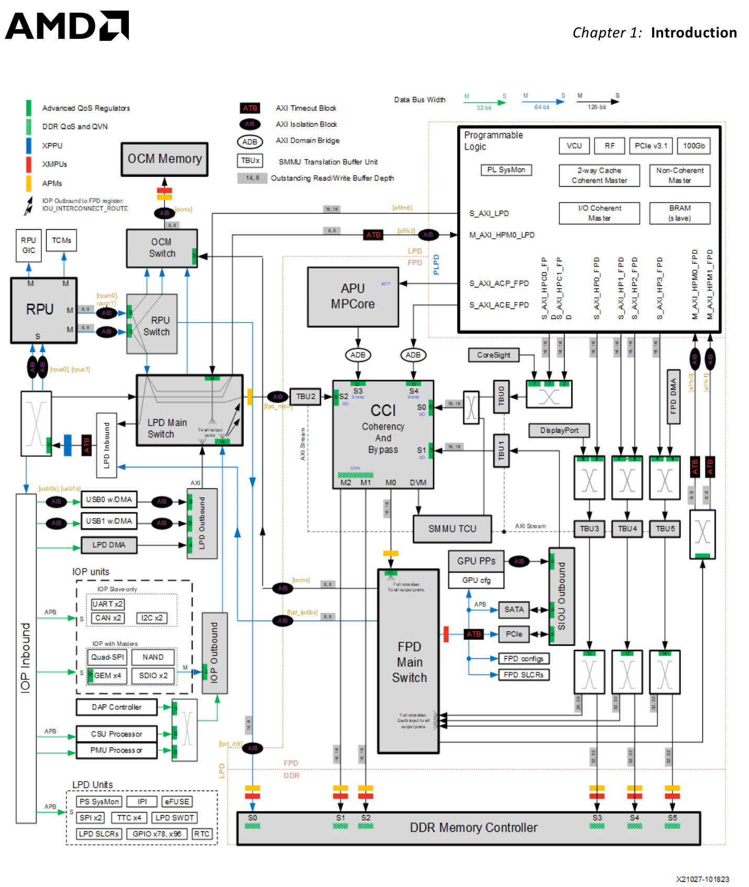
Hardware Cache Coherence Analysis in Zynq UltraScale+ MPSoC: CCI-400 Characterization and APU-RPU Communication Performance
Luigi Caucci, Simone Cecere
Department of Electrical Engineering and Information Technology
University of Naples Federico II
Naples, Italy
Email: {l.caucci, simo.cecere}@studenti.unina.it

Slide 2
System Overview: Zynq UltraScale+ MPSoC Architecture
Heterogeneous Processing Elements
Cache Coherent Interconnect
Application Processing Unit:
Quad-core ARM Cortex-A53 @ 1.33 GHz
32 KB L1 I-cache + 32 KB L1 D-cache per core
Shared 1 MB L2 cache (16-way set-associative)
Runs Linux operating system
64-byte cache line granularity
Real-time Processing Unit (RPU):
ARM CoreLink CCI-400:
Dual-core ARM Cortex-R5F @ 533 MHz
Up to 5 ACE-compliant slave interfaces
32 KB L1 I-cache + 32 KB L1 D-cache per core
2 ACE-Lite master interfaces to DDR
No L2 cache subsystem
Snoop Control Unit (SCU) for coherence
128 KB Tightly Coupled Memory (TCM)
AMBA ACE protocol implementation
Deterministic real-time execution
Base address: 0xFD6E0000
Platform: Kria KR260 Robotics Starter Kit (XCZU5EV variant)

Slide 3


Motivation and Problem Statement
The Cache Coherence Challenge
Heterogeneous processing elements accessing shared memory require robust cache synchronization to ensure correctness and performance.
Problem: APU writes remain in L2 cache (write-back), while RPU reads stale data from DDR.
Software-managed coherence
Non-cacheable memory regions
Hardware-managed coherence
Explicit cache flush/invalidate (CP15)
Designate shared memory as non-cacheable
CCI-400 AMBA ACE protocol
Optimal performance Complex multi-layer system configuration
Significant overhead, complex programming
10–100× slower access latency

Slide 4
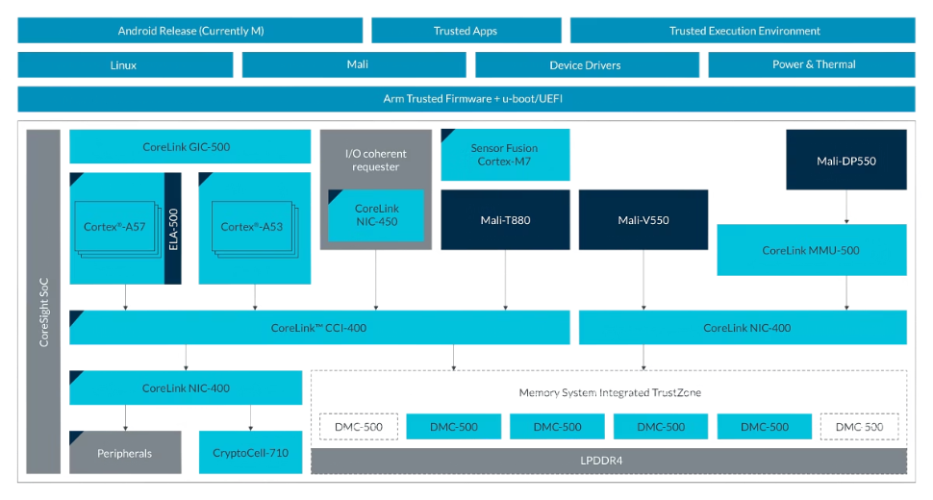

Zynq UltraScale+ Architecture with CCI-400
CCI-400 Interconnect Architecture
The ARM CoreLink CCI-400 Cache Coherent Interconnect implements the AMBA ACE (AXI Coherency Extensions) protocol with three supplementary channels:
AC (Address Channel Snoop): Interconnect sends snoop requests to masters
CR (Response Channel Snoop): Masters reply with cache line state
CD (Data Channel Snoop): Direct cache-to-cache transfer (bypass DDR)
Key Components
Centralized Snoop Control Unit (SCU)
Hardware performance monitoring counters
Multiple coherence domain configurations
Shareability attribute enforcement

Slide 5

Cache Incoherence Scenario
Timeline Demonstration of Complete Cache Incoherence
APU L2
APU writes NEW
At time t₁, the APU writes a NEW value in L2 cache
Due to write-back policy it’s not propagated immediatly to DDR
At time t₂, the RPU reads directly from DDR and observes the stale OLD value
Absence of hardware cache coherence mechanisms.
OLD
NEW
NEW
APU L2
OLD
OLD
OLD
DDR
Critical Finding: This scenario fundamentally compromises both functional correctness and real-time determinism guarantees in heterogeneous embedded systems.
APU L2
STALE DATA
t0
t1
t2

Slide 6






Methodology Overview: Research Approach
Documentation Analysis
Bare-Metal Attempt
Linux with Remoteproc Framework
Userspace Testing via /dev/mem
Kernel Module Development
Performance Characterization

Slide 7


Documentation Analysis
Identified Documentation Gaps
Research Objectives
No integration guide for Linux/Remoteproc with CCI-400
Unclear relationships: PMUFW configuration ↔ FSBL initialization ↔ Device tree
No procedures to verify hardware coherence is actually active
CCI-400 PMU behavior undocumented for Zynq UltraScale+
Kria BSP coherence constraints not explicitly stated
Systematically characterize CCI-400 behavior and configuration requirements
Develop rigorous experimental methodology for cache coherence verification
Quantify software cache management overhead (nanosecond-resolution)
Enablement & Analysis:
Identify and document prerequisites for CCI-400 activation
Provide theoretical performance analysis with functional hardware coherence

Slide 8
Remoteproc Framework and Shared Memory Configuration
Base Configuration
Device Tree Configuration
openamp.dtb
DTB → DTS
Add Shared Memory Region
DTS → DTB
reserved-memory {
#address-cells = <2>;
#size-cells = <2>;
ranges;
// Shared memory for APU-RPU experiments (8 MB)
rpu_shmem@3e000000 {
compatible = "shared-dma-pool";
reg = <0x0 0x3e000000 0x0 0x800000>;
no-map;
dma-coherent;
};
};
Shared Memory Organization
Base Address: 0x3E000000 (8 MB total)
Protocol Control Area: 0x3E000000–0x3E3FFFFF (4 MB)
Results Storage Area: 0x3E400000–0x3E7FFFFF (4 MB)

Slide 9
Kernel Module Design: Definitive Testing Approach
Critical Requirements for Proper Cache Coherence Testing
Producer (APU) - Kernel Module
Consumer (RPU) - Bare-metal Firmware
// Kernel thread running on Cortex-A53
static int writer_thread_fn(void *data) {
while (!kthread_should_stop()) {
// Test Case 1: Write with explicit cache flush
test_buffer[0] = PATTERN_A;
__asm__ __volatile__("dc cvac, %0" :: "r"(&test_buffer[0]));
__asm__ __volatile__("dsb sy" ::: "memory");
msleep(50);
// Test Case 2: Write without cache flush
test_buffer[0] = PATTERN_B;
__asm__ __volatile__("" ::: "memory");
msleep(50);
}
return 0;
}
// Polling loop on Cortex-R5F
while (1) {
// Invalidate cache before reading
Xil_DCacheInvalidateRange((INTPTR)shared_mem, 64);
uint32_t value = shared_mem[0];
if (value == PATTERN_A) {
coherent_reads++;
} else if (value == PATTERN_B) {
incoherent_reads++;
}
}
visible to RPU (flushed to DDR)
Cache flush worked - coherency maintained
Should NOT see this - indicates cache problem
retained in APU L1 cache (invisible to RPU)

Slide 10

Experimental Results: Definitive Cache Incoherence
Stress Test Results: 100,000 Consecutive Read Operations
Run
Reads
Stale
Fresh
Coherence
Configuration Verification Status
Prerequisite
Status
Layer
1
100,000
100,000
0
0%
Device tree CCI-400 node
✓
OS
2
100,000
100,000
0
0%
dma-coherent property
✓
OS
3
100,000
100,000
0
0%
Shareability attributes
✓
OS
Total
300,000
300,000
0
0%
RPU0_CFG COHERENT bit
✓
Register
XPAR_LPD_IS_CACHE_COHERENT
✗
Vivado
Observation:
RPU reads OLD pattern 300,000/300,000 times
NEW pattern (in APU cache) never detected
Conclusion:❌ CCI-400 hardware coherence is non-functional❌ No snoop operations occurring
PMUFW broadcast enable
✗
Firmware
FSBL snoop port enable
✗
Firmware
Critical Finding: Three missing prerequisites in standard BSP.
Custom firmware modifications are needed.

Slide 11

Testing Protocol and Stress Test Implementation
Communication Protocol Sequence Diagram
APU
TTC0
DDR (shared_mem)
RPU
read tstart
Wait for START (invalidate cache)
Write payload, size, tstart, START
Invalidate metadata
Read size, tstart
Wait for ACK
Invalidate payload
read tend
Shared Timer Infrastructure
Triple Timer Counter 0 (TTC0):
Calculate Δt
Base address: 0xFF110000
Clock frequency: ~100 MHz
Write result, ACK
Time resolution: 10 ns
Counter width: 32-bit
Shared hardware clock eliminates drift

Slide 12
Cache Invalidation Overhead: Scaling Characteristics
Base Overhead Components: Small packets (1–64 bytes, single cache line) exhibit approximately 1.5–1.7 µs baseline overhead comprising:
Polling loop detection latency: ~1.0 µs
Control word and metadata cache invalidation: ~120 ns
Memory barrier instruction execution (DSB): ~50 ns
Protocol state machine overhead: ~300 ns
Large Packet Cache Invalidation Cost: For the maximum 64 KB packet with 1024 cache lines:
Tinvalidation ≈ 1024 × 60 ns = 61.4 µs
Experimentally measured value: 63.4 µs, demonstrating excellent model agreement with prediction error below 3%.

Slide 13



Theoretical Coherent Scenario Performance Model
CCI-400 Hardware Coherence Model
With functional CCI-400:
No explicit software cache invalidation required
Automatic coherence via hardware snoop mechanisms
Eliminates ~60 ns/line software overhead
Result: Direct performance improvement without programmer intervention
Theoretical Transport Time Model
Snoop Transaction Latency Breakdown
$$T_{coherent}=T_{proto}+n_{lines}+T_{snoop}+size/BW_{DDR}$$
Parameter
Description
Value
Base interconnect traversal: ~50 ns
Snoop address broadcast: ~100 ns
$$T_{proto}$$
Protocol overhead
350 ns
Agent responses (3 × 20 ns): ~60 ns
Total round-trip: ~210 ns
$$T_{snoop}$$
Per-line snoop latency
210 ns
$$BW_{DDR}$$
Effective DDR bandwidth
10.5 GB/s

Slide 14
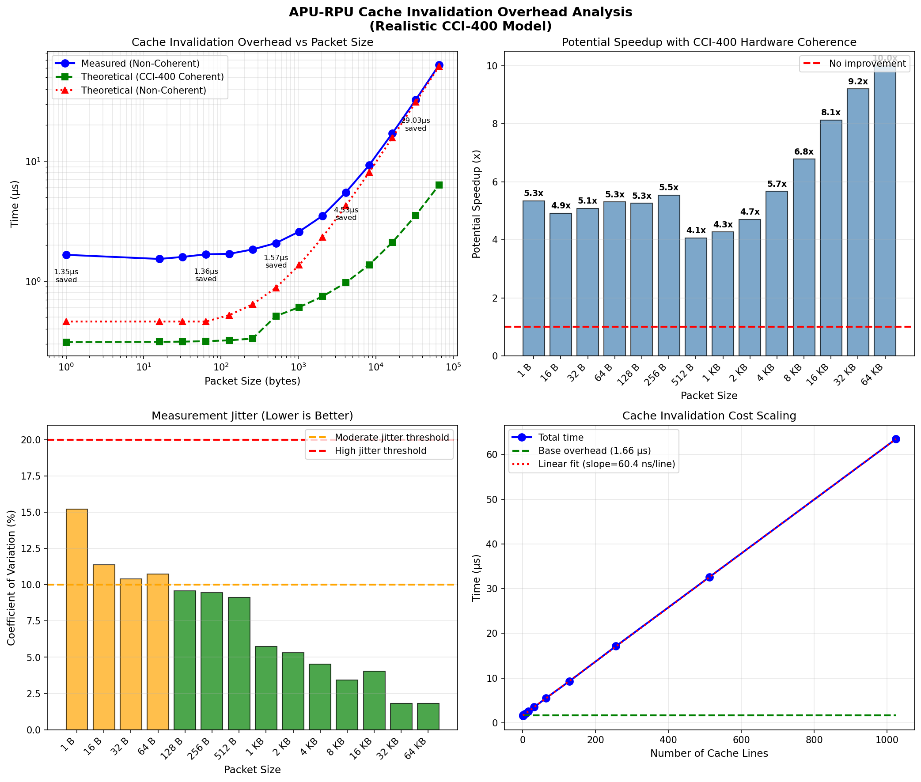
Theoretical Coherent Scenario Vs Actual Measurements
Performance Measurements & Predicted values
Size (B)
Non-Coherent (µs)
Coherent (µs)
Speedup
1
1.658
0.310
5.3×
64
1.674
0.315
5.3×
1024
2.588
0.606
4.3×
4096
5.499
0.969
5.7×
16384
17.127
2.107
8.1×
65536
63.443
6.342
10.0×
Geometric Mean:
5.7×
Key Performance Characteristics
Measured Performance:
~60 ns per 64-byte cache line
Linear scaling with cache line count
Cost Components:
CP15 DCIMVAC instruction execution
DSB synchronization barrier overhead

Slide 15
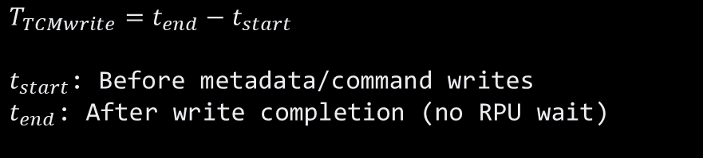
TCM Baseline Characterization
Validating Cache Overhead Isolation
Why TCM Baseline?
Measurement Methodology
Establish architectural lower bound for memory access latency
Validate cache overhead measurements independently
Zero cache involvement → pure hardware timing
Confirm CCI-400 model predictions
$$T_{TCMwrite}=t_{end}−t_{start}$$
$t_{start}$: Before metadata/command writes
$t_{end}$: After write completion (no RPU wait)
Research Objectives
Memory location: 0xFFE00000 (R5F_0 ATCM)
Capacity: 64 KB total (32 KB ATCM + 32 KB BTCM)
Access pattern: APU write-only (consistent with cache overhead measurement)
Timing: Identical TTC0 infrastructure @ 100 MHz
Protocol: Same APU-RPU communication structure

Slide 16
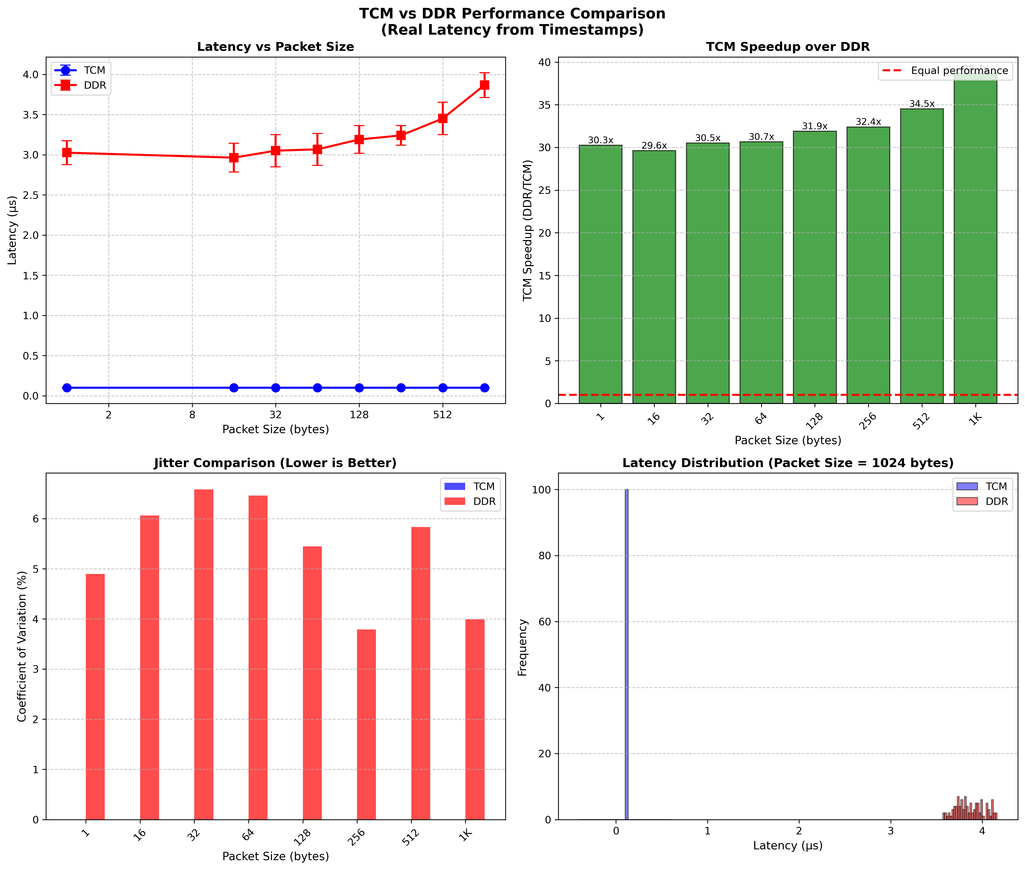
TCM vs DDR: Comparison Plot
Comparative Results
Latency
Capacity
Coherency
Use Case
TCM
0.61 μs
64 KB
N/A
<1KB real-time
DDR (no-CCI)
3.50 μs
4 GB
Software
Current baseline
DDR (w/CCI)
0.51 μs*
4 GB
Hardware
Target
*Predicted from validated model
Key Findings
Cache overhead isolated: 3.50 - 0.61 = 2.89 μs
5.7× penalty from software cache management
Model validation: TCM (0.61 μs) ≈ CCI pred. (0.51 μs)
60 ns/line confirmed: 2.89 μs ÷ 48 lines ≈ 60 ns
Critical Insight TCM proves sub-μs is achievable WITHOUT cache overhead, validating our CCI-400 speedup predictions

Slide 17
TCM and CCI-400: Complementary Solutions
Requirements:
Computer vision: Multi-MB image buffers exceed TCM
Neural networks: Weight tensors (MBs) cannot fit
Sensor fusion: Aggregate data streams too large
Ideal for ultra-small (<1KB) real-time control loops
TCM Role:
Proves cache overhead is dominant factor
Validates theoretical CCI-400 model
Confirms sub-μs latency achievable
Cannot replace CCI for general-purpose use
Criterion
TCM
DDR + CCI
Latency
0.61 μs
0.51 μs (pred.)
Capacity
64 KB
4 GB
Scalability
Fixed 64KB
Expandable
APU access
0.61 μs
0.51 μs
Use cases
Tiny buffers
All workloads

Slide 18




Conclusions: Principal Findings
Coherence Verification
Software Overhead Quantification
CCI-400 Potential Performance
100,000 iterations: 100% stale data reads
Proof: CCI-400 hardware coherence is disabled
Cache invalidation: ~60 ns per 64-byte cache line
Scales linearly with cache line count
Predicted speedup: 4–10× improvement
Average: 6× faster across packet sizes
Critical Missing Prerequisites
XPAR_LPD_IS_CACHE_COHERENT Macro
Requires custom Vivado hardware design
Not available in standard Kria BSP
PMUFW Broadcast Enable
Platform Management Unit must configure IPI controller
Enables RPU snoop request propagation through CCI-400
FSBL Snoop Port Configuration
First Stage Bootloader (EL3 privilege) must program CCI-400 registers
Enable hardware snooping on slave port S2 (RPU interface)
Critical Conclusion:
CCI-400 requires complete custom Vivado project from scratch
This negates the value proposition of using pre-integrated commercial platforms

Slide 19






Limitations and Future Work
Limitations and Assumptions
Future Research Directions
Polling Overhead: Measured latencies include ~1 μs RPU polling variability (interrupt-based mechanisms would reduce this)
Custom Vivado Design: Develop hardware satisfying all CCI-400 prerequisites for experimental validation
Interrupt Mechanisms: Replace polling with mailbox interrupts to reduce latency and improve power efficiency
Single RPU Core Utilization: Experimental measurements utilize one R5F processor core. Activating both RPU cores would double coherence-related snoop traffic
Multi-Core Analysis: Test both RPU cores simultaneously to study snoop contention and arbitration
Synthetic Communication Pattern: Regular periodic packet transmission does not comprehensively represent all possible inter-processor communication patterns
Representative Workloads: Evaluate performance with real applications (ADAS sensor fusion, industrial control)

Slide 20
Thank you for your attention!
Luigi Caucci M63001679
Simone Cecere M63001681
Università degli studi di Napoli Federico II

